Slide 1

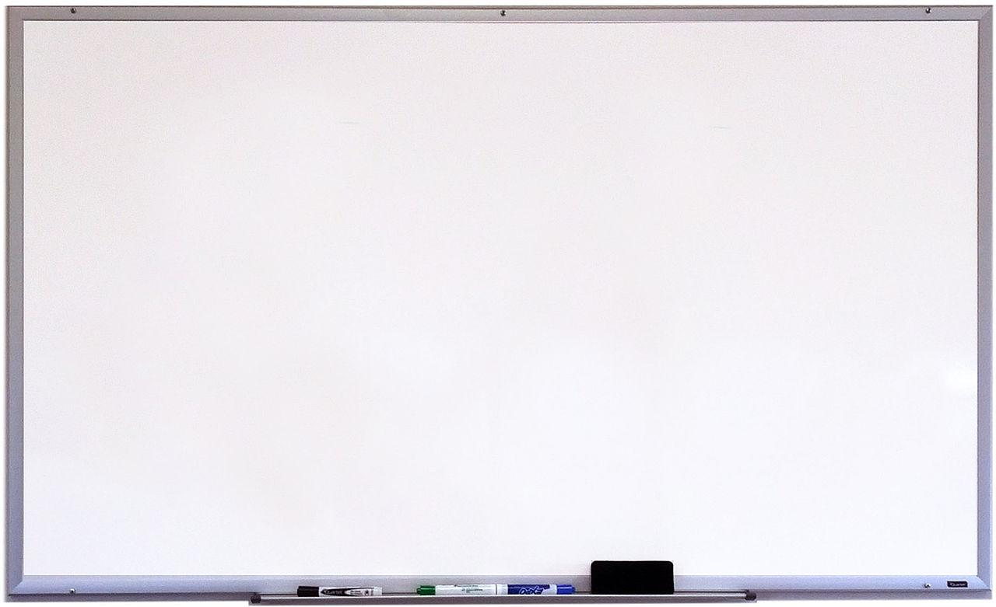
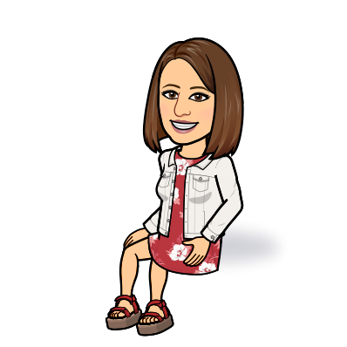

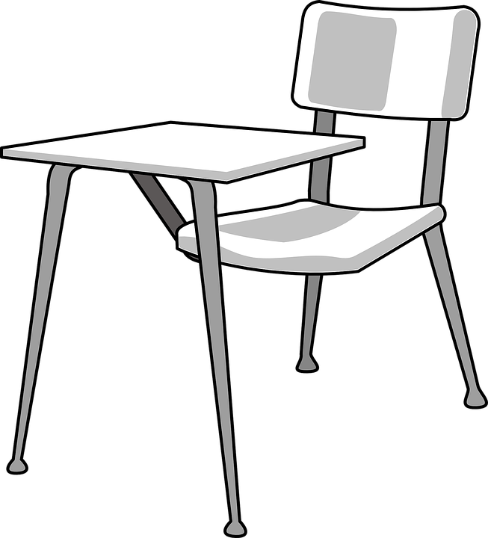

Hello!
My name is Tina Cardinali and I am the new ESOL teacher for your school.
I am very excited about the upcoming school year. I have heard wonderful things about the Woodland Cluster and I am looking forward to our time together.
About Myself:
This is my twenty first year as a certified teacher and my twentieth year in Henry County. Over the years, I have enjoyed teaching second/third grade math/reading at Liberty Elementary School in Tennessee, sixth grade science/reading at Austin Road Middle School, second grade EIP at Flippen Elementary School, seventh/eighth grade science/social studies at Hampton Middle School, first grade at Troup Elementary School in Connecticut, and eighth grade ELA special education at Union Grove Middle School. This is my second year serving as an ESOl teacher and I look forward to our year together.
English
Language
Learners
You
are Amazing!
Ms. Cardinali, ESOL Teacher
tina.cardinali@henry.k12.ga.us

